Slide 1


Slide 2
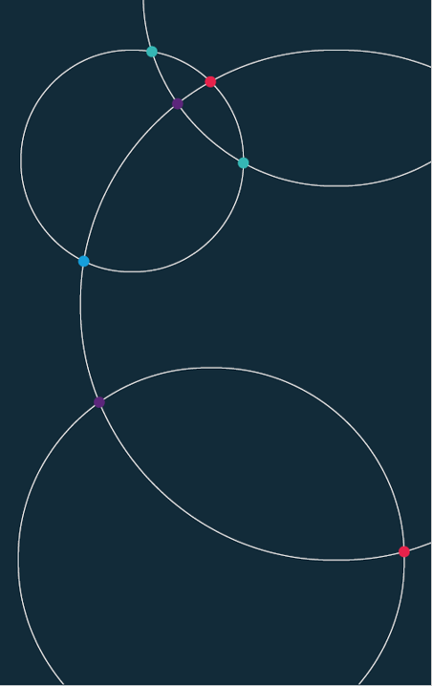
Practical Data Science. For economists Week 8. University of Bristol Autumn 2024

Slide 3
Week 8.
Motivation. Some maps from the ECO team
History. Origins of social cartography.
Mapping today. Modern examples.
How to make maps. The nuts and bolts of cartography.
Code-along. Building your first maps.

Slide 4

8. Maps. Data in geographic context

Slide 5
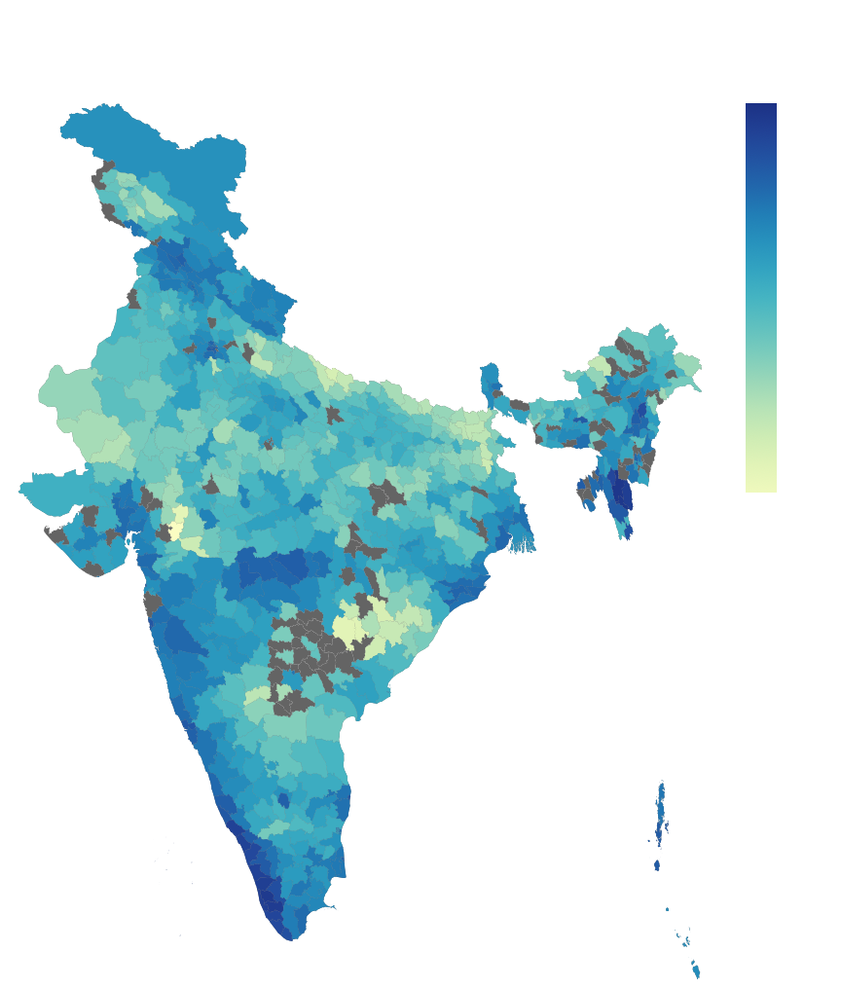
The world’s biggest economy.
India
Every ten years, the Indian state conducts the largest census of any democracy.
The last was completed in 2011 – the 2021 census has been delayed post-Covid.
Two and a half million census workers visited thousands of towns and 600,000 villages to ask 27 questions of 1.2 billion people.
This map shows the literacy rate of each of India’s districts.

Slide 6
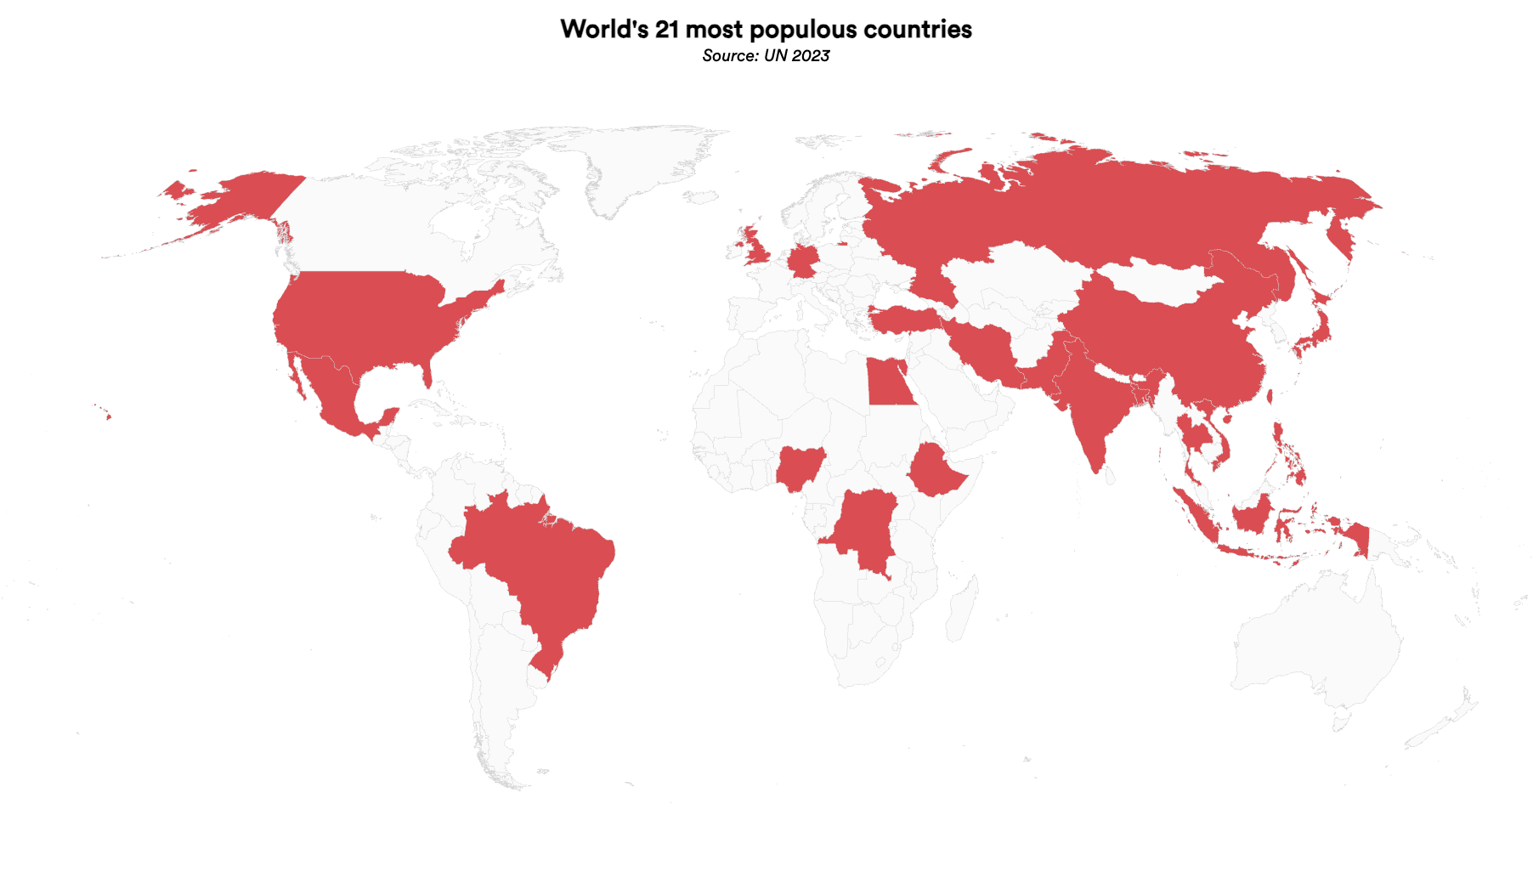
20 economies that drive the world.
Plus the UK, number 21…

Slide 7
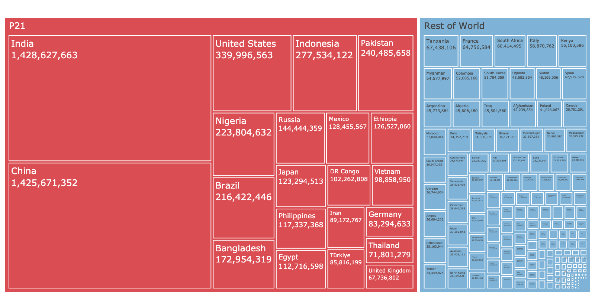
Economies that drive the world.
21 countries make up 71% of the global population

Slide 8
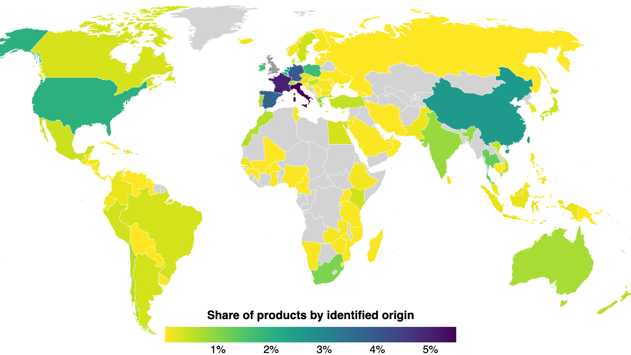
Where does Britain’s food come from?
Our research.
Across 67,000 products from 6 UK supermarkets.
Just under half are of UK origin (49%).
Top five foreign sources of food (in order) are Italy, France, Germany, China and Spain.
Prodcuts sourced from at least 71 countries.

Slide 9
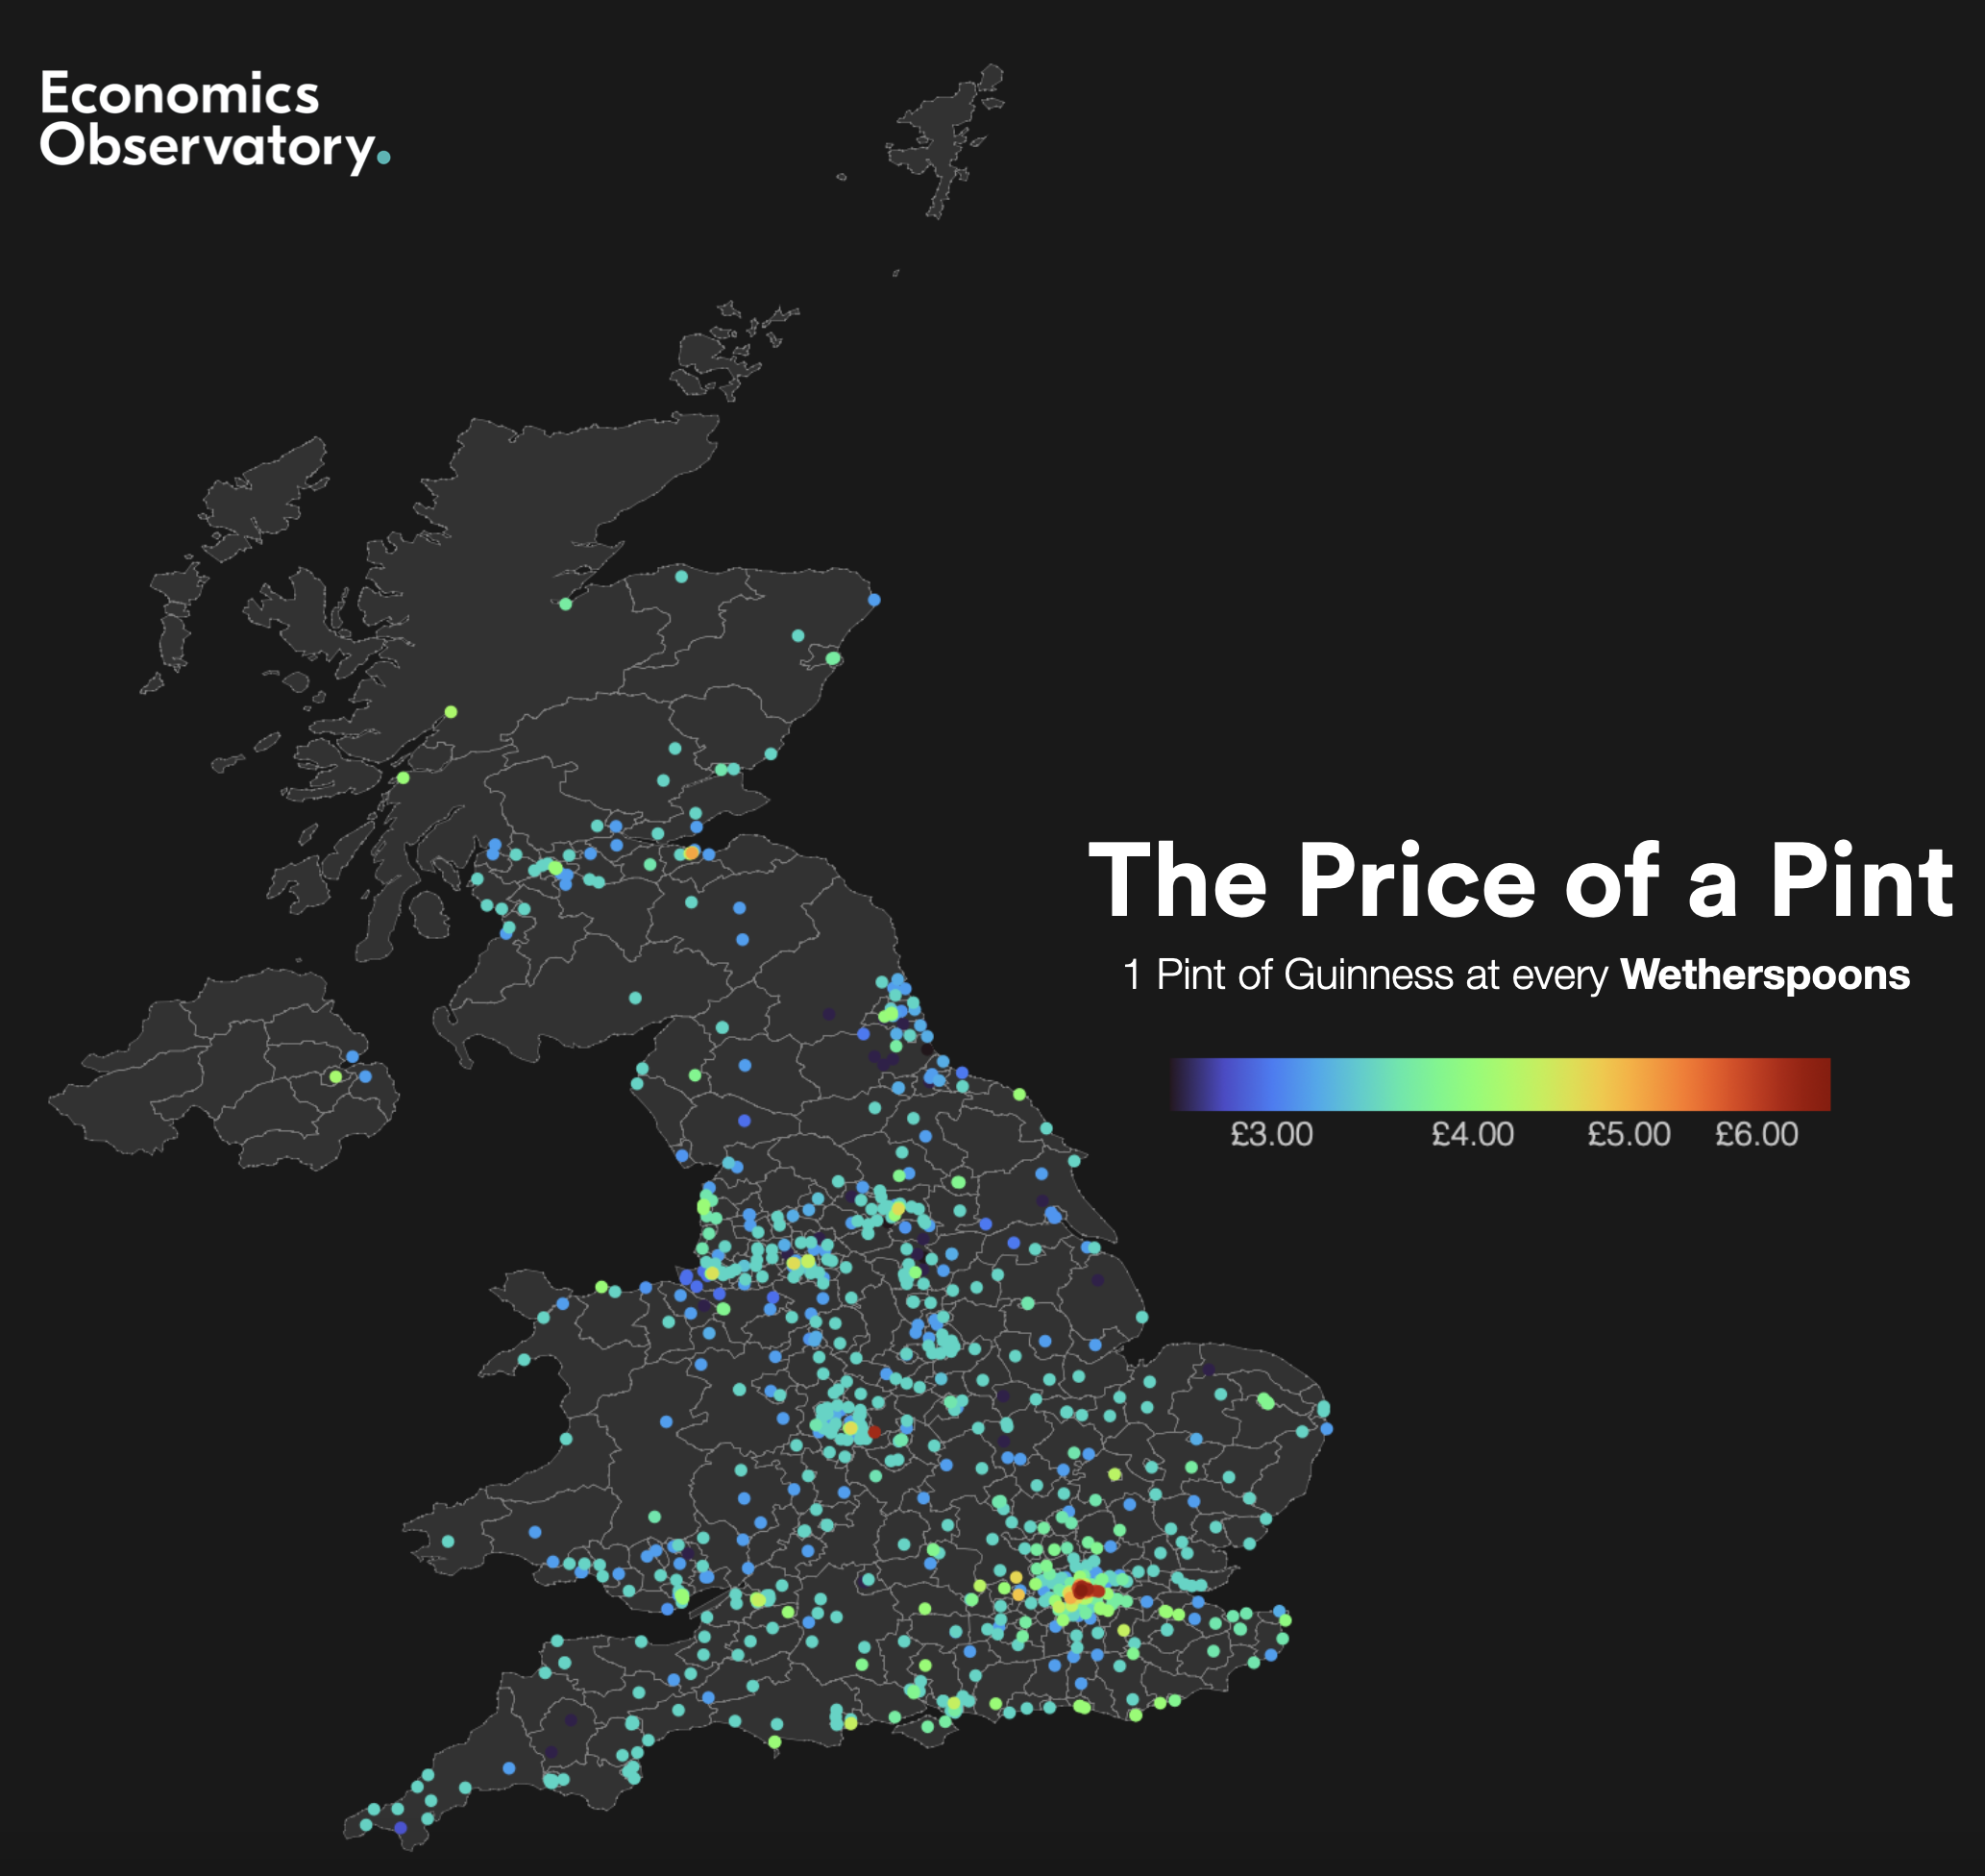
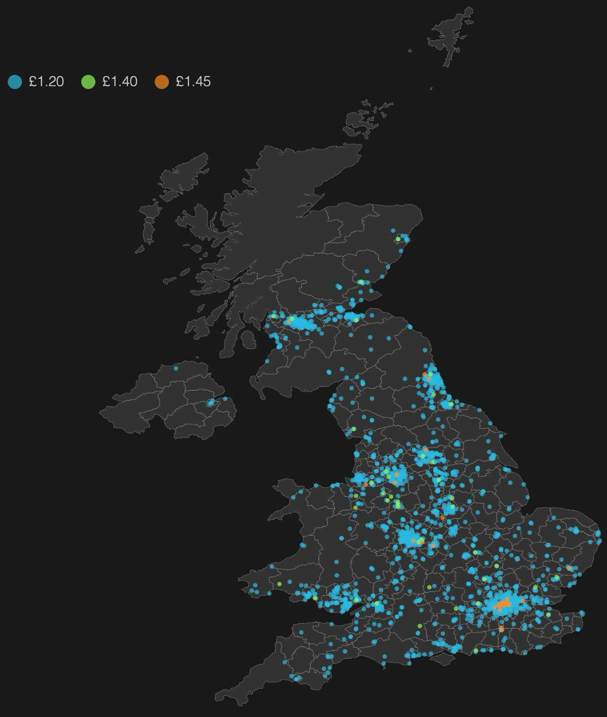


Guinness, 1 pint, Wetherspoons
Vegan sausage roll, Greggs

Slide 10

8.1 History. Why do humans make maps?

Slide 11
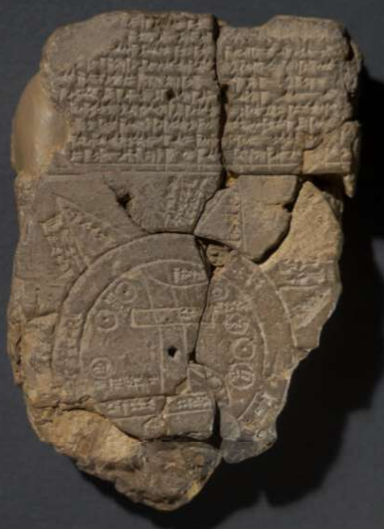
Cartography.
A potted history
600 BC. Babylonian World Map.
801. Tang Dynasty. Hainei Huayi Tu (海内華夷圖)
Map of Chinese and non-Chinese Territories in the World
1527. Diogo Ribeiro (Portuguese), the Pádron Real.
1569. Gerardus Mercator (Flemish). World Map.
In this course we are not interested in maps on their own. Rather we want to plot economic and social data on maps. This is known, historically, as social cartography.
The historical focus has been social concerns: illness, poverty, and deprivation.

Slide 12
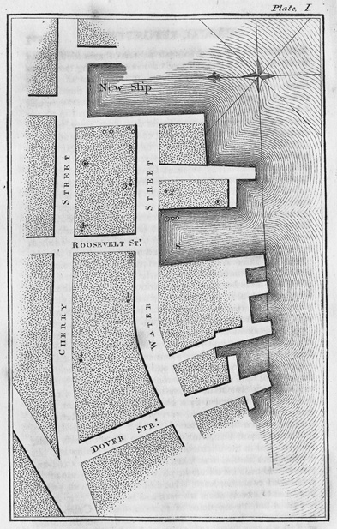
Valentine Seaman- Yellow Fever
Dr Valentine Seaman (1796). An Inquiry into the Cause of the Prevalence of the Yellow Fever in New-York
The first example of plotting illness on a map.
1795 yellow fever epidemic.
Cause of the spread was unknown – was it ships from tropics?
[It is spread by mosquitos]
Seaman mapped ships and waste sites, along with cases of the disease.
Cutting edge study (but did not correctly identify mosquitos as the carrier).

Slide 13
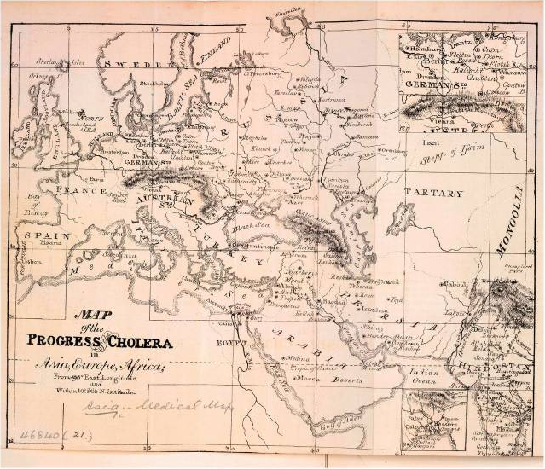
Global Health - Cholera
The Lancet (1831).
Maps were used in the first example of global health analytics.
This one plots towns and cities known to have cholera outbreaks.

Slide 14
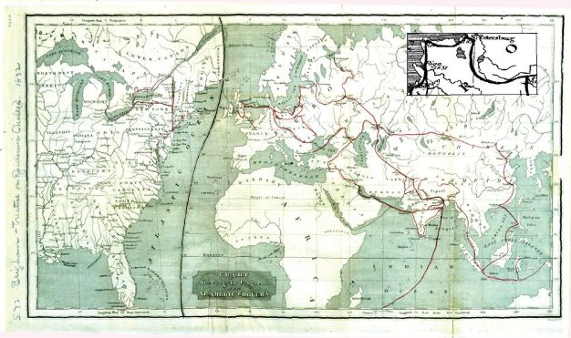
Amariah Brigham - Cholera
Amariah Brigham (1831). A Treatise on Epidemic Cholera
Theme emerging: early map makers are trying to establish causality
The hypothesis: a link between human travel and disease.
The finding: trade and illness followed the same routes across continents.
[Cholera is a bacterial infection, and transmitted through food or water contaminated with human waste]

Slide 15
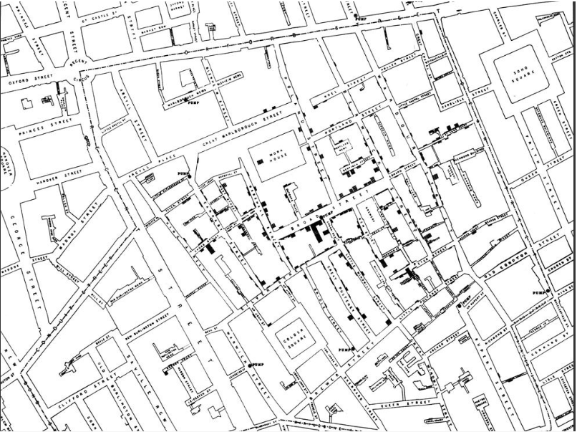
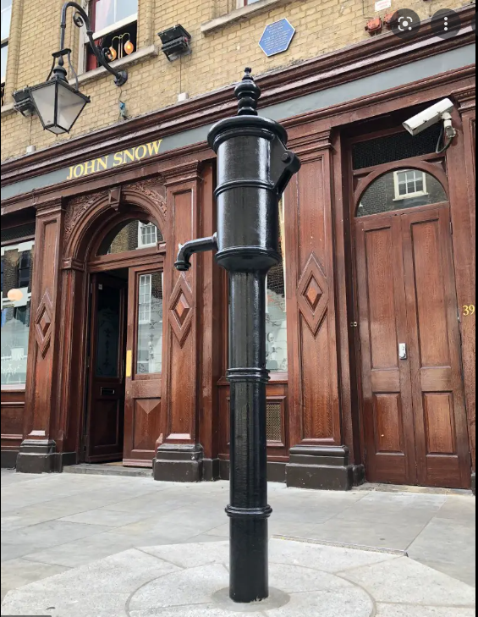
John Snow - Cholera
Dr. John Snow, father of epidemiology, 1854.
https://www.theguardian.com/news/datablog/interactive/2013/mar/15/cholera-map-john-snow-recreated

Slide 16
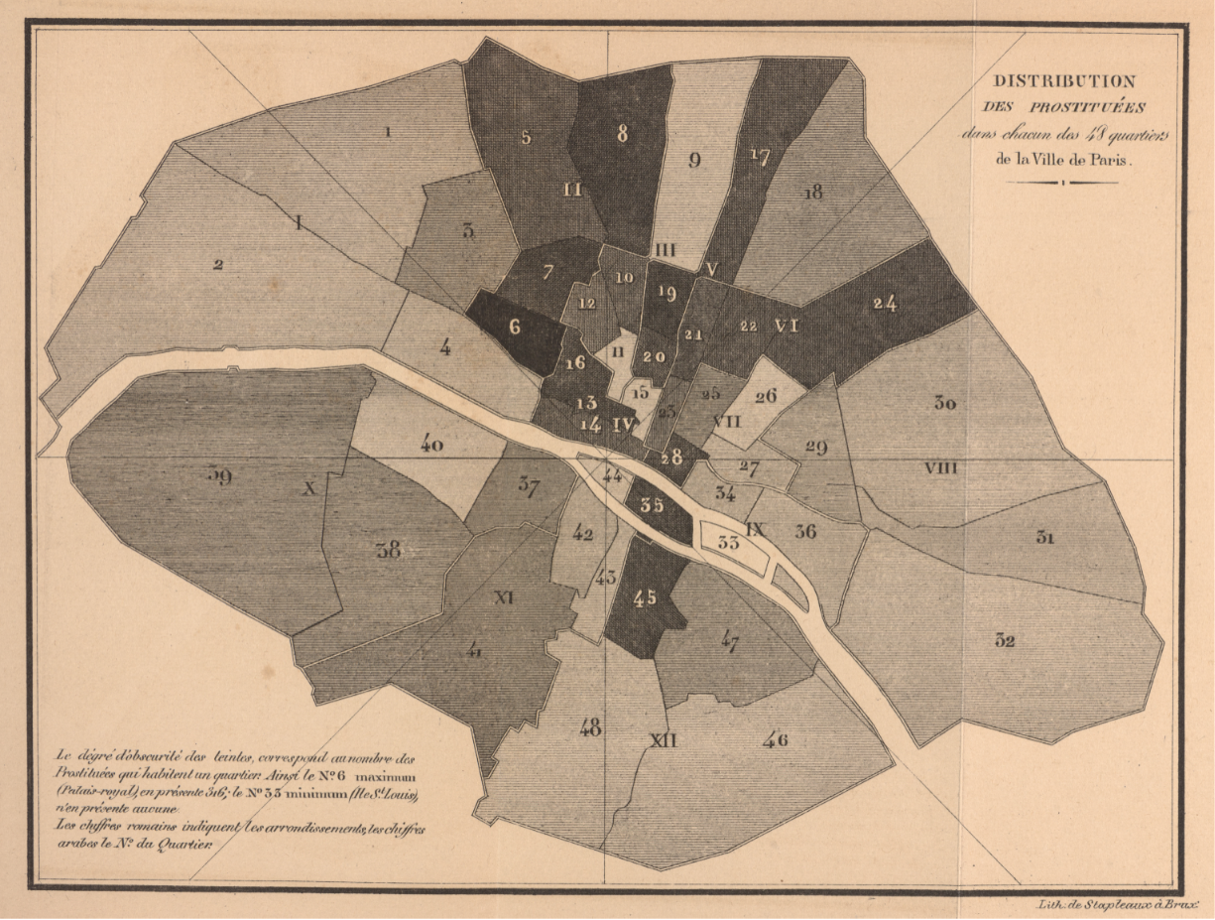
Parent du Châtelet - Prostitution
Distribution des Prostituees dans chacun des 48 quartiers de la Ville de Paris
https://digital.library.cornell.edu/catalog/ss:3293767

Slide 17
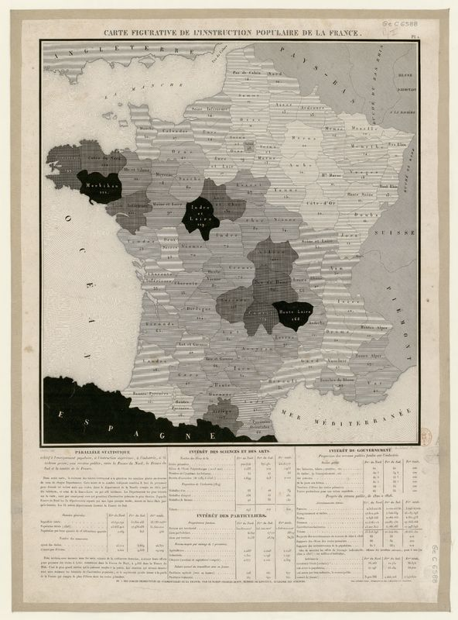
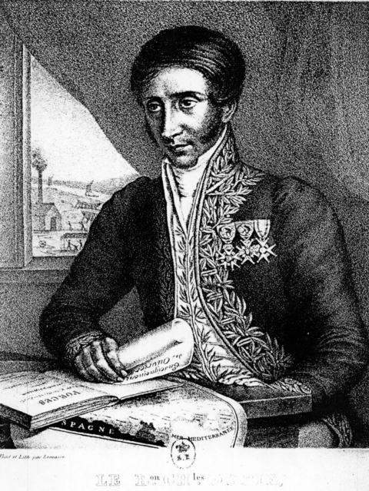
Pierre Charles Dupin
The emergence of tinted maps (1827)
Choropleth map:
A term from 1938 (geographer John Kirtland Wright)
From Greek: choros 'area/region', plethos 'multitude’.
Earliest versions had simpler name: cartes teintées.
To make visible the main difference, I had the idea to give to the various départements shades all the more dark since they sent less pupils to schools. Dupin (1827)
What explains low literacy rates?

Slide 18
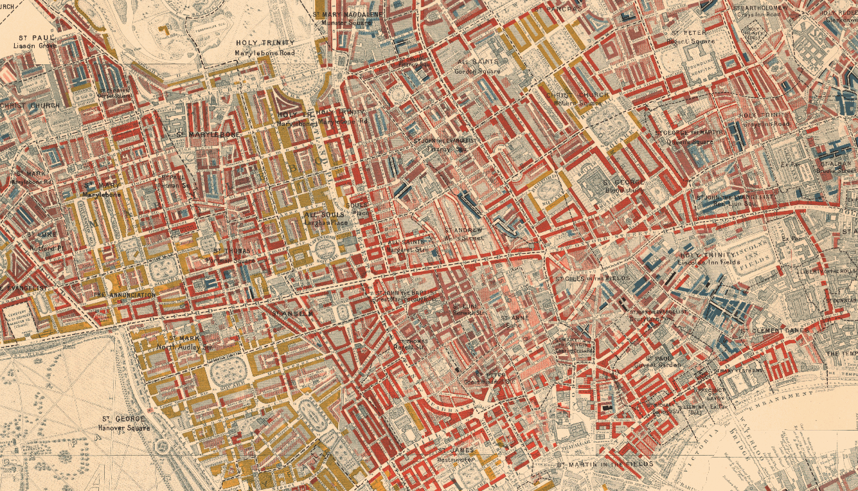
Charles Booth – Poverty
Inquiry into the Life and Labour of the People in London
Vital historical survey
Undertaken between 1886 and 1903
Examined working class life C19th
Notes and data have survived
A milestone in development of the methodology of social investigation in the United Kingdom.
https://booth.lse.ac.uk/map/14/-0.1203/51.5212/100/0
Notes:
Lowest class. Vicious, semi-criminal. Black
Very poor, casual. Chronic want. Dark blue
Poor. 18s. to 21s. a week for a moderate family. Light blue Mixed.
Some comfortable others poor. Purple
Fairly comfortable. Good ordinary earnings. Pink
Middle class. Well-to-do. Red
Upper-middle and upper classes. Wealthy. Yellow

Slide 19
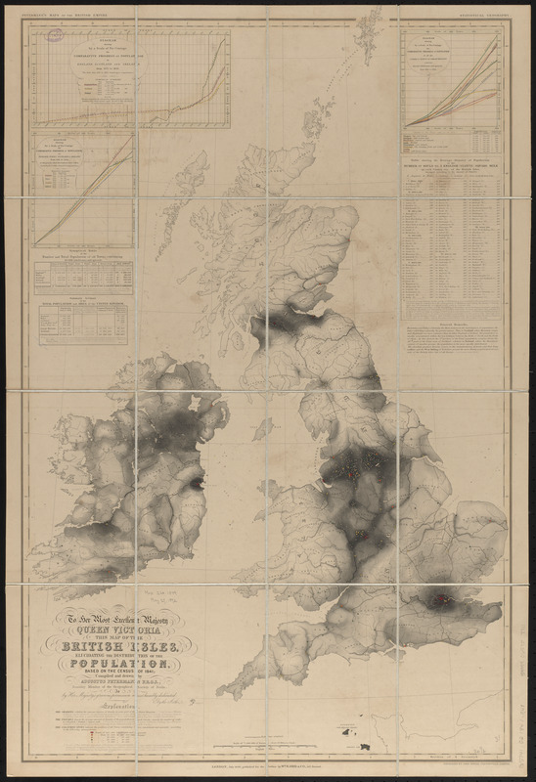
Augustus Petermann – Population
Mapping Census data (1849)
Augustus Petermann was a prominent German geographer known for his pioneering work in thematic cartography.
He worked in the UK producing population maps.
This map from the 1841 census shows the population distribution of the British Isles.
Modern incarnation, the latest ONS mapping tool:
ONS Census Maps
Gilbert (1958) “Pioneer Maps” - https://www.jstor.org/stable/pdf/1790244.pdf

Slide 20
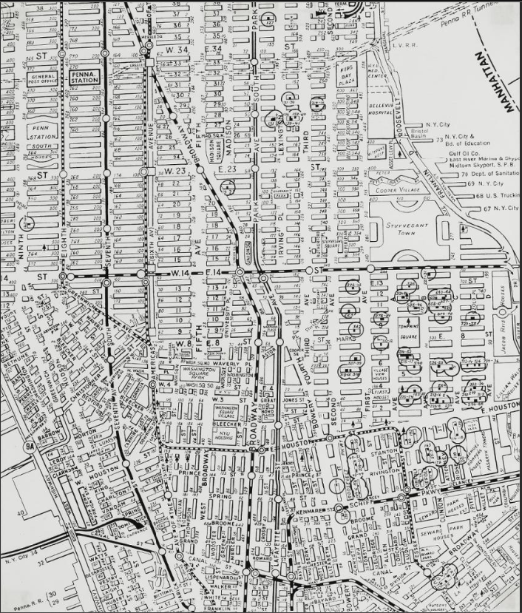
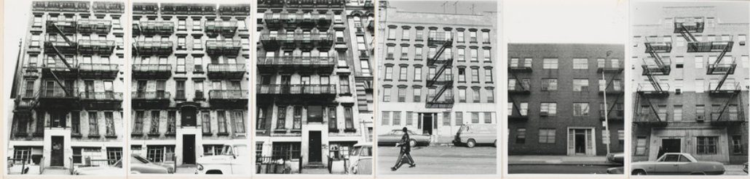
Hans Haacke
Manhattan. Maps and photos used in a work of art and social commentary
Shapolsky et al. Manhattan Real Estate Holdings, a Real-Time Social System, as of May 1, 1971.
https://whitney.org/collection/works/29487

Slide 21

London – the Greenwich meridian
Where time starts
By the late 19th century, sailors navigated around the world relying on maps centred on their country of origin.
There became the need for a consistent global reference point.
Simultaneously, railways and telegrams linked cities in minutes, while each city kept its own time zone — Bristol, for example, eleven minutes behind London.
The Greenwich Meridian standardized navigation and unified global time and positioning.
Modern version – the IERS reference meridian
https://www.iers.org/

Slide 22



Rival standards
The Thames and the Seine
Paris Meridian
A long-standing rival, running through the Paris Observatory.
It was defined in 1667, and was essential for the triangulation mapping of France.
International Meridian Conference
The Greenwich meridian became a global standard in 1884, when it was adopted at the conference in Washington DC.
Refining the standard
The IERS Reference Meridian, which is a refinement and formalization of the Greenwich Meridian, passes 102 meters east of the Greenwich Meridian. It passes through the Earth’s centre of mass rather than aligning with the gravitational direction at Greenwich.

Slide 23
8.2 Modern mapping. Uses of maps in economic and policy settings

Slide 24
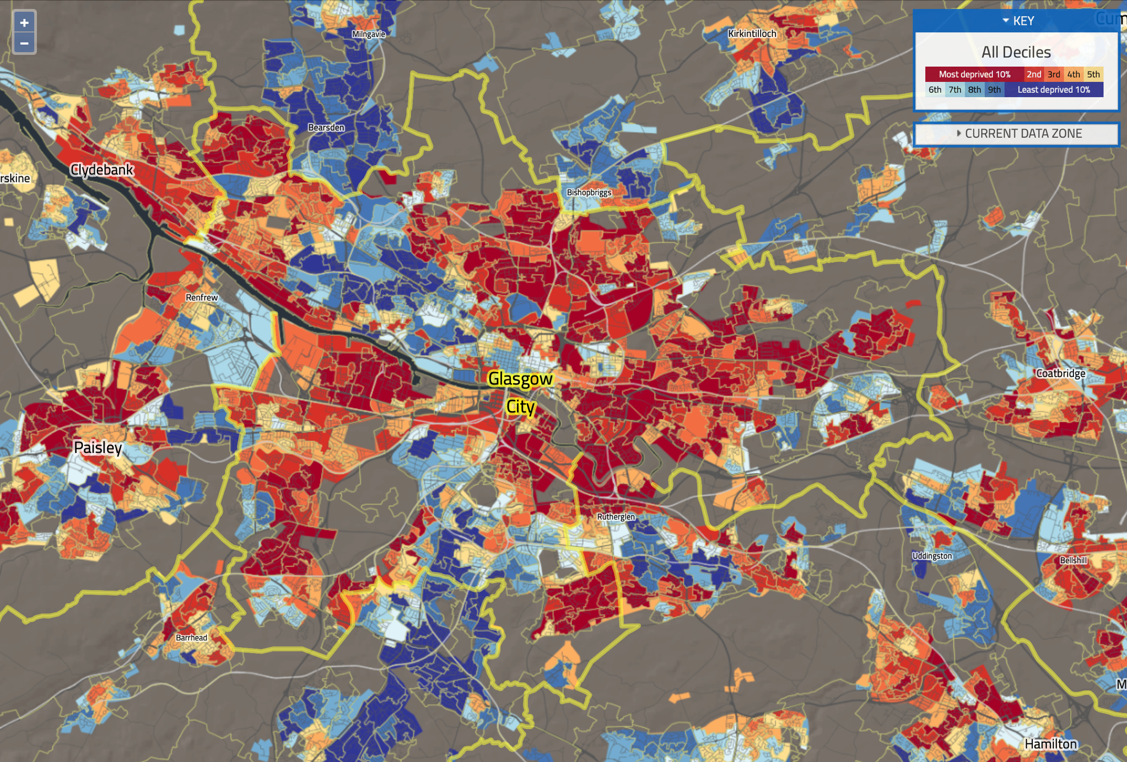
Glasgow – Deprivation
Population Health in Glasgow
Glasgow, Scotland’s largest city by population, is one of the UK’s most deprived areas.
Demographers and epidemiologists have long debated a ‘Glasgow effect
Its life expectancy is among the lowest in Europe and lower than expected, even after accounting for poverty.
This map shows large neighbourhood variations in deprivation.
Scottish Index of Multiple Deprivation

Slide 25
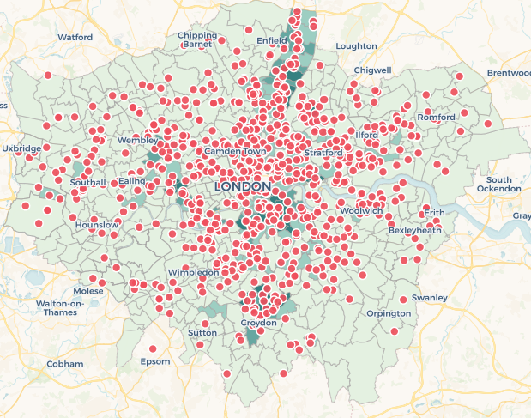
London – Crime
Tom Kirchmaier’s work with the Police
https://sites.google.com/site/tomkirchmaier/links-data

Slide 26
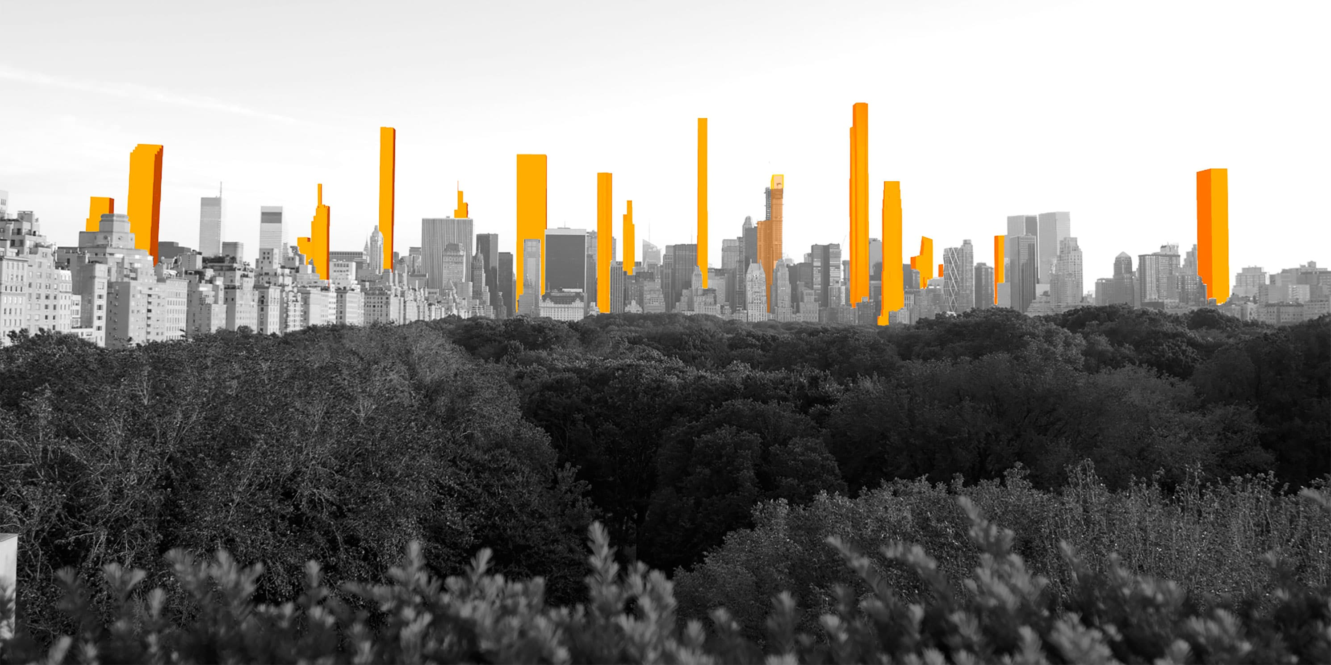
Manhattan – Shadows
The rise of super tall building and the problem of predicting shadows
https://www.mas.org/interactive_features/accidental-skyline-shadows/

Slide 27
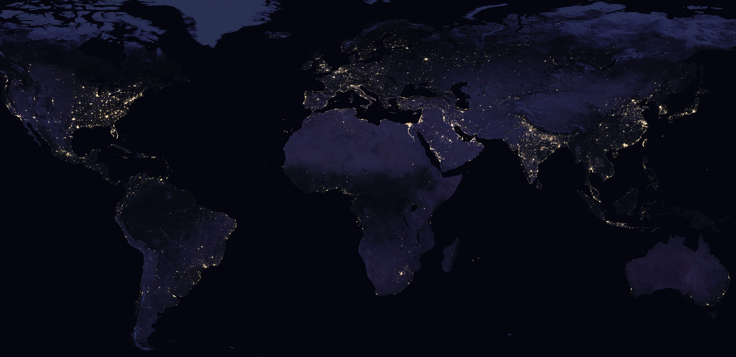
NASA – The Earth at Night
Nasa, and others, produce detailed night-light satellite imagery:
https://earthobservatory.nasa.gov/features/NightLights/page3.php

Slide 28
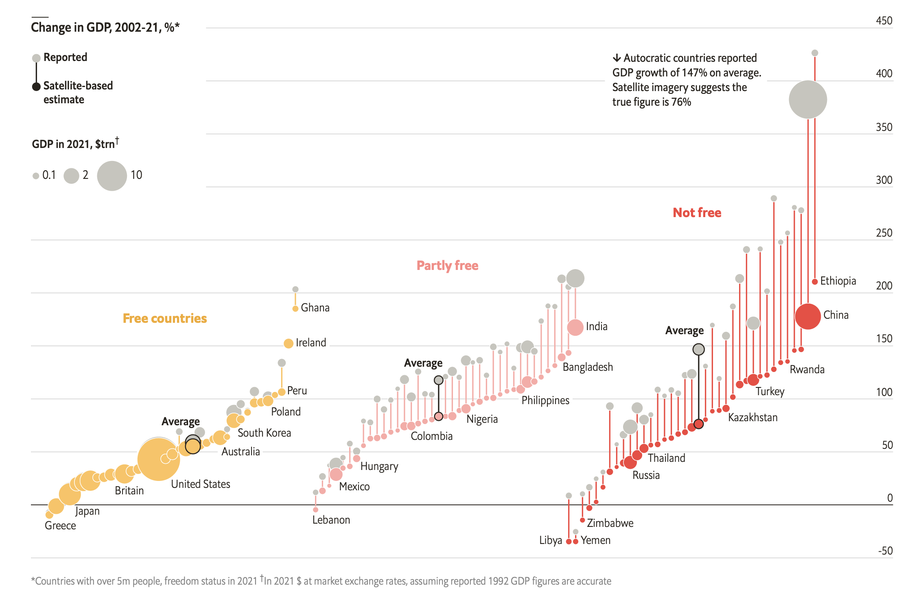
Nightlight
Economic (mis)measurement
Nightlight data can be used as a proxy for economic activity.
This is useful where data is missing, or can’t be trusted.
Martinez (2022) uses nightlight data to show that autocracies systemically overreport their economic performance.
A study of lights at night suggests dictators lie about economic growth, The Economist

Slide 29
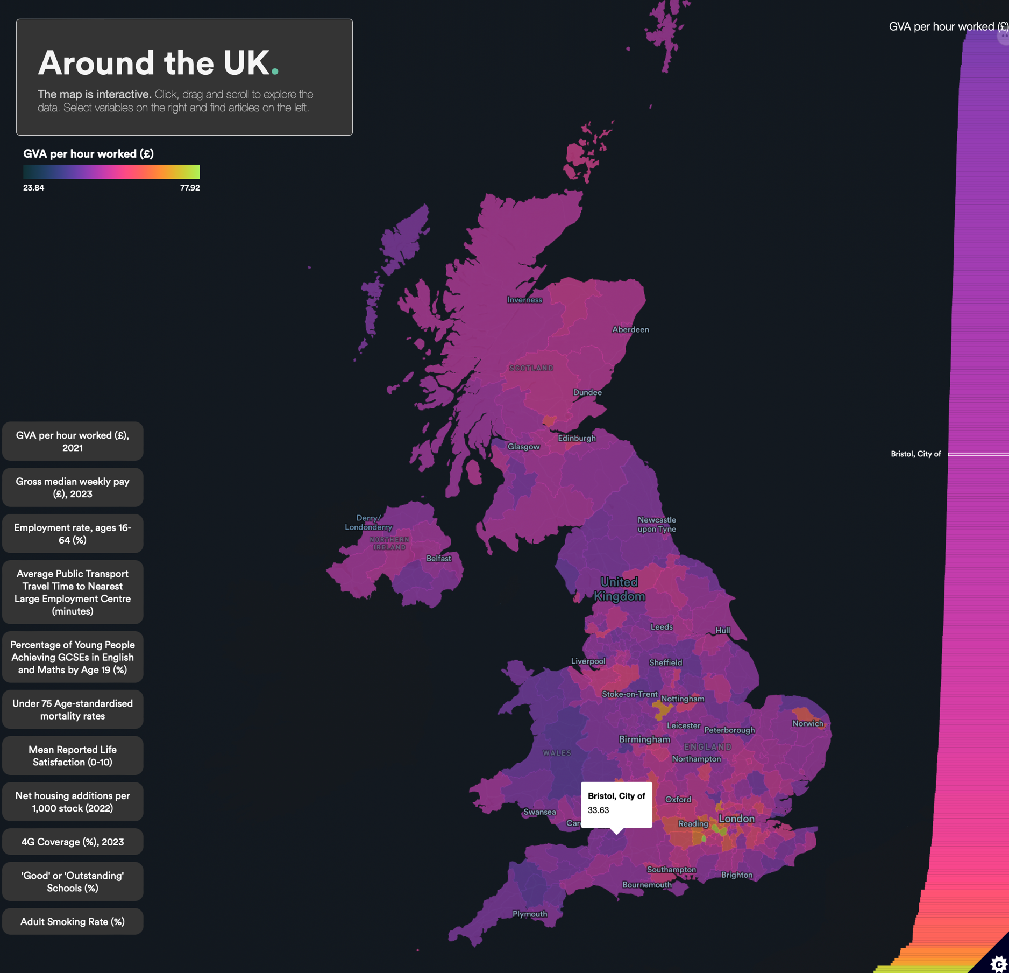
Modern maps.
More interesting examples
Justice Map – Crime in the US
justicemap.org
Deforestation
globalforestwatch.org/map/
ONS Census Maps
ons.gov.uk/census/maps/
ECO Around the UK
economicsobservatory.com/data-hub/sandbox/map

Slide 30
8.3 Map making. The theory and tools you need to make maps

Slide 31
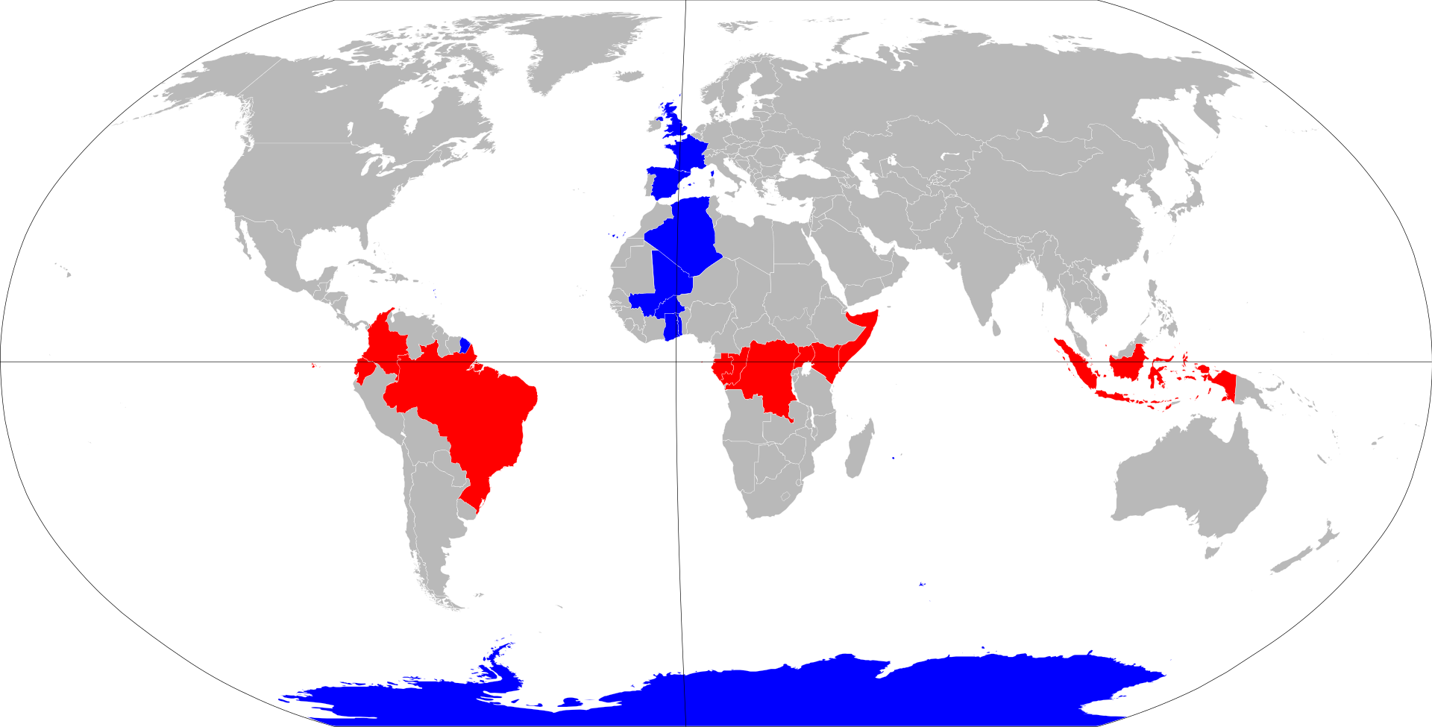
Key terms.
Some of the key terms that you will see when building your own maps
Longitude
Appear as vertical lines. Measured from Prime Meridian in degrees.
IERS Reference Meridian (close to Greenwich Meridian), used in Global Positioning System (GPS).
0° at the Prime Meridian, from +180° Eastward to – 180° Westward.
Latitude
Appear as horizontal lines. Measured as degrees.
-90° at North Pole, 0° at the Equator, +90° at the South Pole.

Slide 32
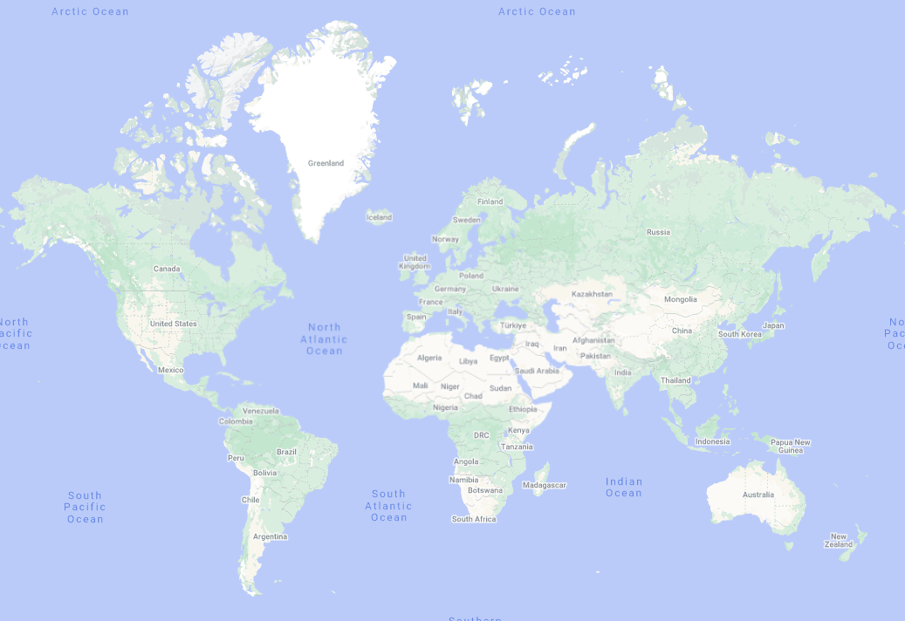
Our world map.
On Google maps

Slide 33
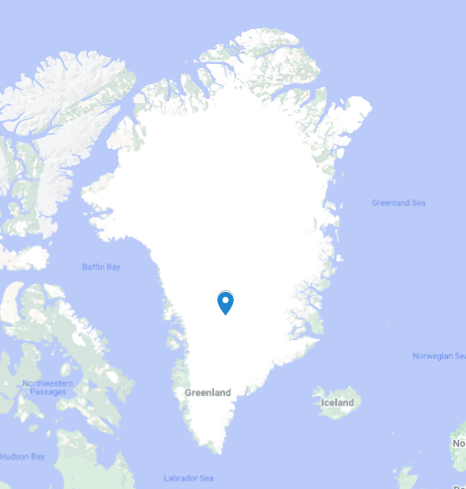
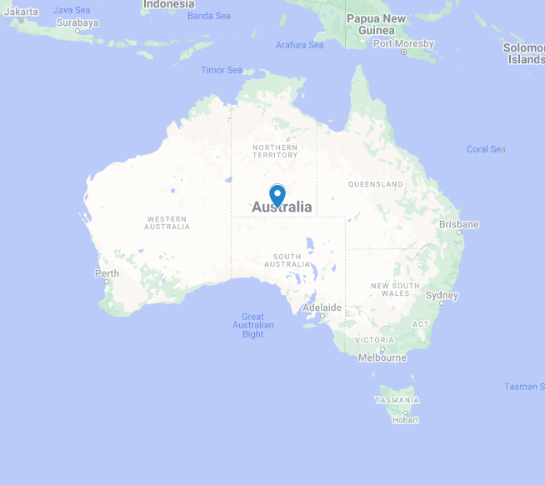
Which is bigger?
Greenland vs Australia

Slide 34
Which is bigger?
Greenland vs Australia
2.166 million km²
7.741 million km²

Slide 35
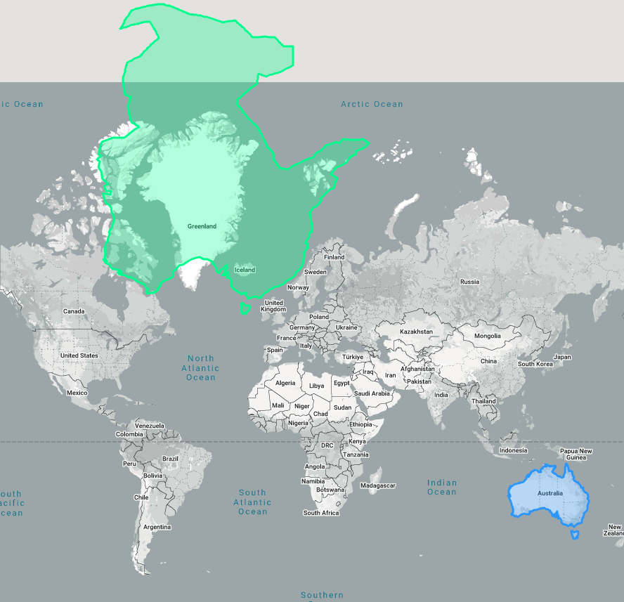
Which is bigger?
Greenland vs Australia
The maps we’re used to are distorted.
Try this tool: thetruesize.com

Slide 36
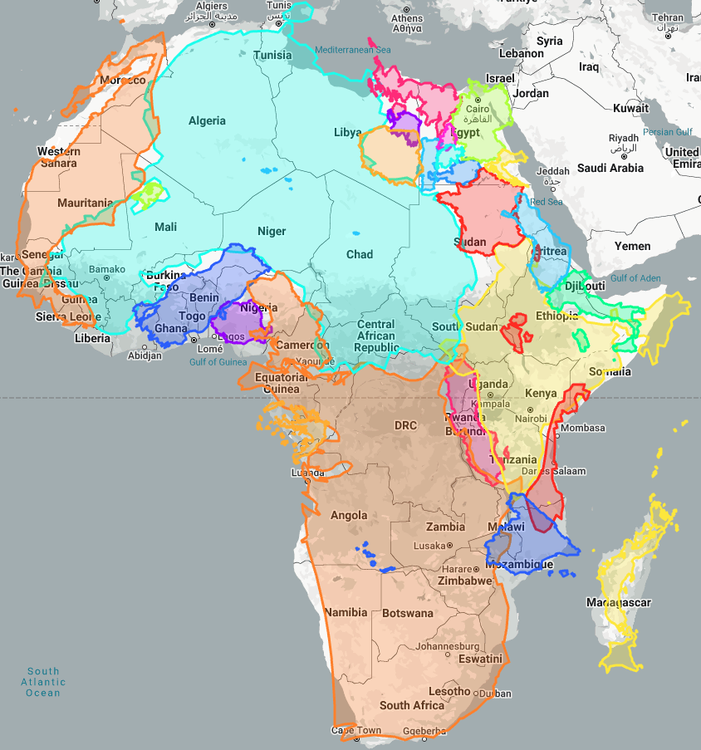
True size of Africa.
Bigger than you thought.
Here is USA, China, India, Mexico, Türkiye, Ukraine, France, Spain, Sweden, Norway, Japan, Germany, Finland, Poland, Italy, Romania, UK, Greece, Portugal, Austria, Ireland, Croatia, Netherlands, Switzerland, Belgium
Combined, these 25 countries are roughly the same size as Africa.
Africa: 30.4 million km²
Notes:
True size of - https://www.thetruesize.com/
True size of (Africa vs 25 countries map): https://www.thetruesize.com/#?borders=1~!MTQyOTA4NjE.NDIxMjc1Mw*MjgwMTQwOTQ(MTA0MzU5Njk~!CONTIGUOUS_US*MTM0NzAzNTI.MjYwNDU0MjI(Njk)Mg~!IN*NTAxNTM3Mw.NzEzODg5OQ)MQ~!CN*OTA2MTkxOQ.MTA5MTU5MzE(MjM)MA~!GL*MA.MTgwMDAwMDA)MA~!JP*MTA3MDkyODE.NzUwMTQ1NA(MzM2)MQ~!MX*OTIxNDc5OQ.MjQ4NzM3Mzc(MjU5)Mg~!ES*NzA5ODE5OQ.MzE4NjgwODA(MjIw)Mw~!GB*MzQzMzc1Mg.MzEwODk2NjU(MTMy)NA~!FR*NDYwMzYyNA.MzA5NDU4NTg)NQ~!DE*MzEzMDI4Mg.MzE3MzA4ODA)Ng~!PT*MzgyMzU0NA.Mjg2OTIxOTQ)Nw~!IE*Mzg2MTAzNg.MzA1MzMwOTM(MTIw)OA~!PL*MzAzODU3MA.MzU0MzI4MTI)OQ~!IT*NDc5NTI1NA.MzExMTE2MDQ(MTU1)MTA~!AT*MzA0MjQ3OQ.MzI3ODMxOTQ)MTE~!BE*MzMyNzc2Mg.MzE0NDg1MjQ(MjU5)MTI~!CH*MzAyMDgxNw.MzE3MzYwNjA(MTU0)MA~!HR*Mjg2MDE5Ng.MzE5MTUwNjQ(MTY2)MQ~!UA*NDk0MzE1Mw.Mjk2Nzk3Mg(MjI4)Mg~!TR*NDU2NTUzNQ.NTUwOTIzMg(MTQ1)Mw~!SE*NzI2Mjk3MA.MzQ1MDI0Nzg(MTQ2)NA~!NO*ODA4NDA4Ng.MzM3ODgyODY(MTU2)NQ~!NL*MTgyNjkyMA.Mjg1NTQzMw(MjIx)Ng~!FI*NTQ3NjMyNg.MzQ1MTk4Mjc(MTUx)Nw~!RO*NDU5ODI4Ng.MjkwNjI2OA)OA~!GR*NDc3NjUxMw.MTc4MjMwNg(MzI5)OQ

Slide 37
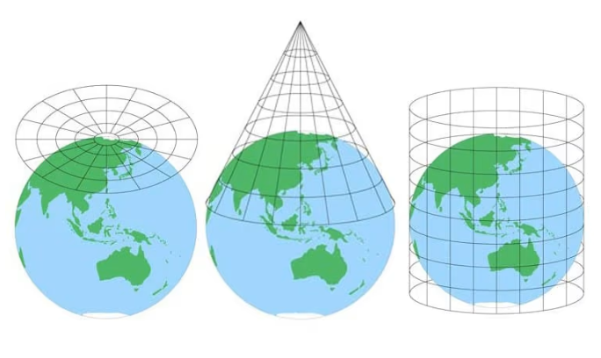
Projections.
Turning a sphere into a flat surface
Map projections represent spherical data on a flat surface.
In 1827, mathematician Carl Friedrich Gauss proved that all map projections must introduce distortion. It is impossible to flatten a curved surface while preserving distance, angle, and area simultaneously.
Every map projection is, therefore, a trade-off. Common approaches are:
Azimuthal Equidistant
Conic
Cylindrical (e.g. Mercator)
https://blog.mapchart.net/misc/quick-guide-to-map-projections/
Notes:
No single two-dimensional map can accurately display both shape and size because it’s transposing a three dimensional object.

Slide 38
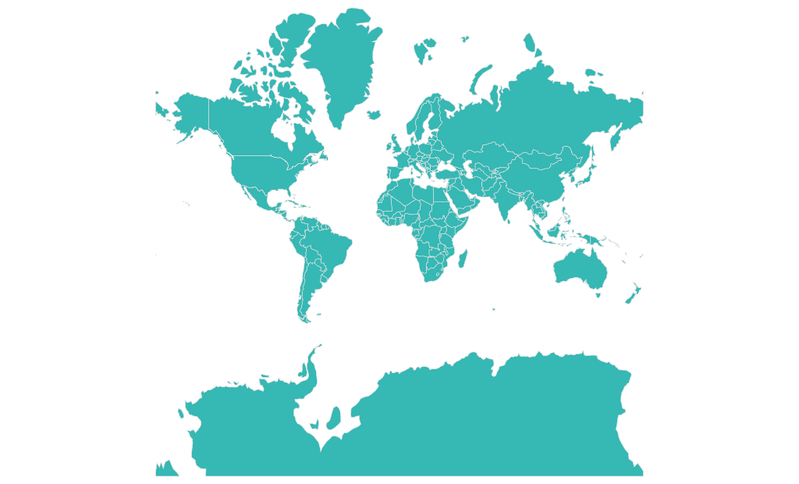
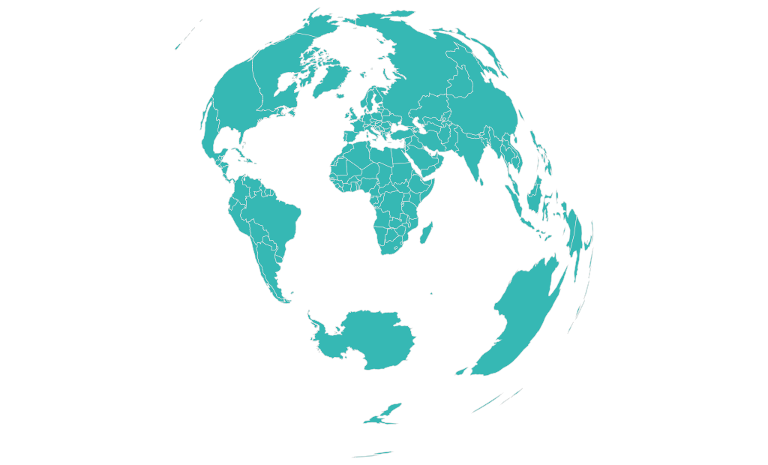
Projections.
Common choices
Mercator
Azimuthal Equidistant

Slide 39
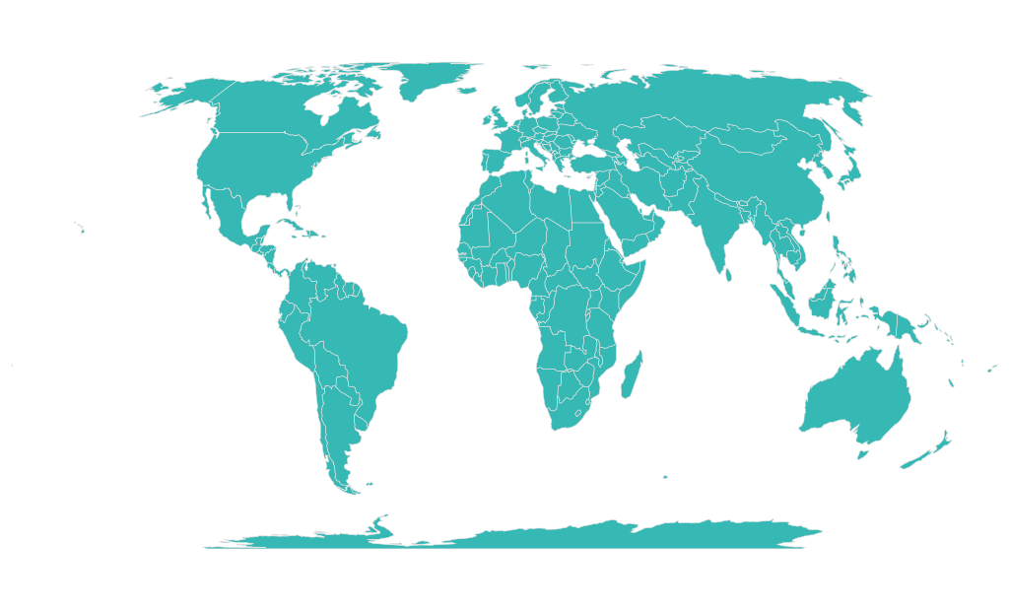
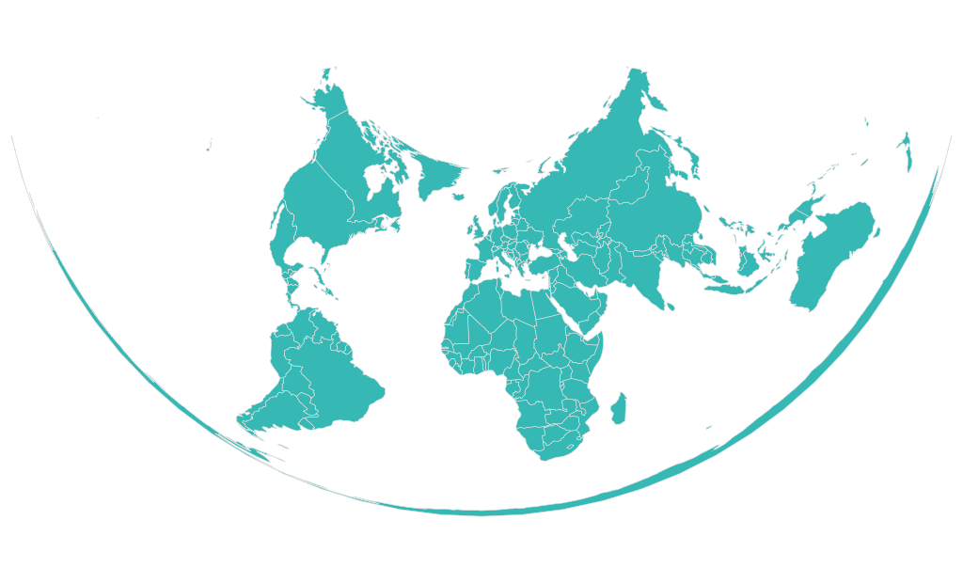
Projections.
Common choices
Conic (equal area)
Equal Earth

Slide 40
Projections.
Picking a projection
Each approach trades off distance, angle, and area.
Projection | Distance | Angle | Area
Conic (Equal Area) | Good | Poor | Good
Equal Earth | Moderate | Moderate | Good
Mercator | Poor | Good | Poor
Azimuthal Equidistant | Good | Moderate | Poor
The Equal Earth projection, designed to balance shape and area with moderate accuracy in distance, is a decent middle ground.
The right projection, though, is context-dependent. For example, if visualising navigation paths, then the Mercator projection works well. But if equal area representation is needed, then Conic (Equal Area) or Equal Earth are better suited
Equal Earth

Slide 41
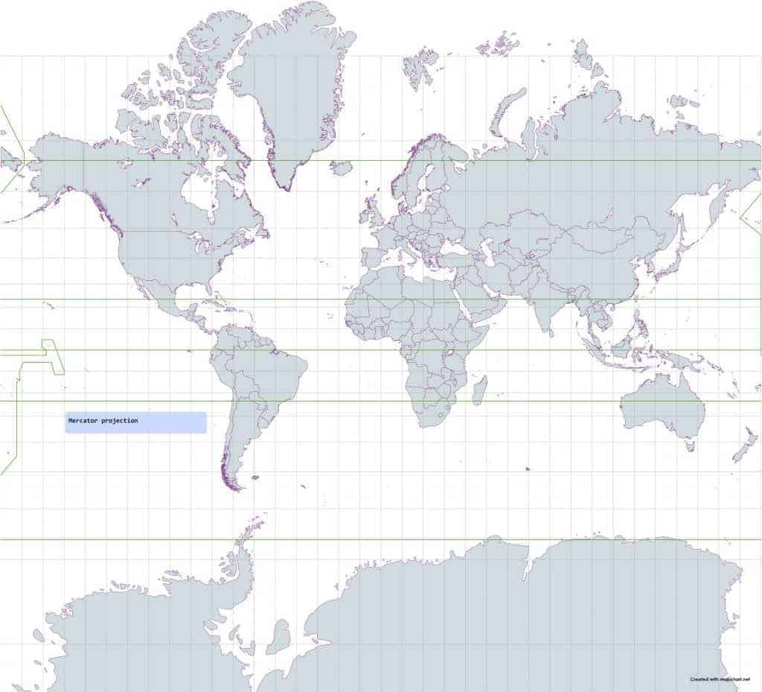
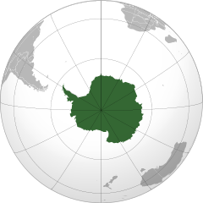
Projections.
All projections distort…

Slide 42
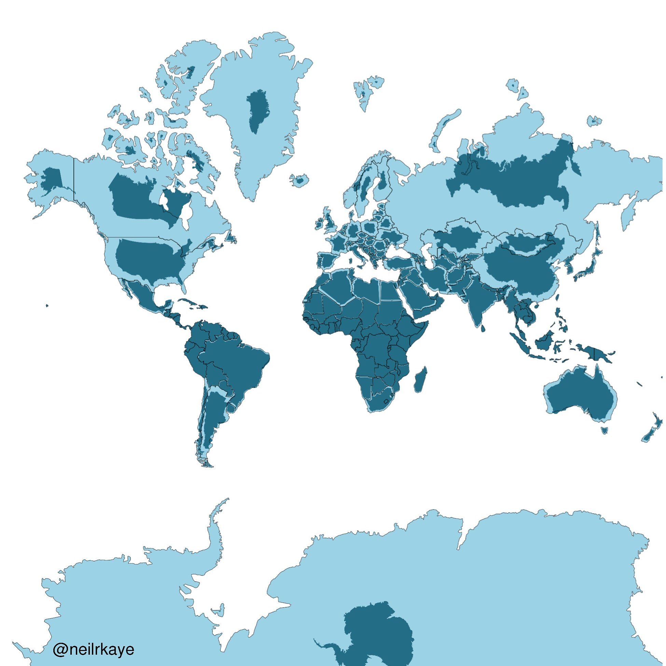
Projections.
Mercator projection, with true shape overlaid.
Consider carefully how representation impacts perception: the Mercator projection significantly distorts the Southern Hemisphere.
For example, Africa is 14 times the size of Greenland but appears similarly sized with the Mercator projection.
https://twitter.com/neilrkaye

Slide 43
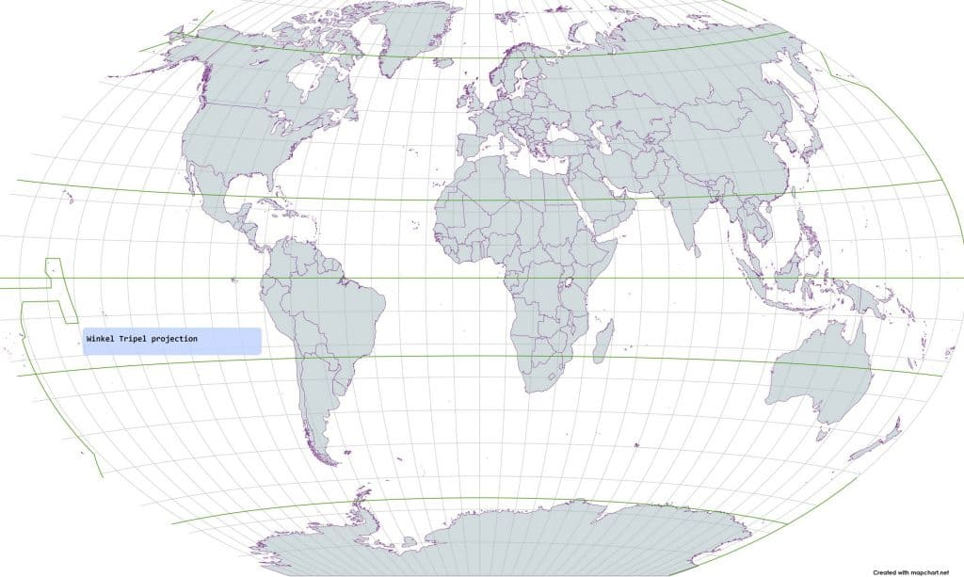
Projections.
Winkel Tripel projection
Used by National Geographic

Slide 44
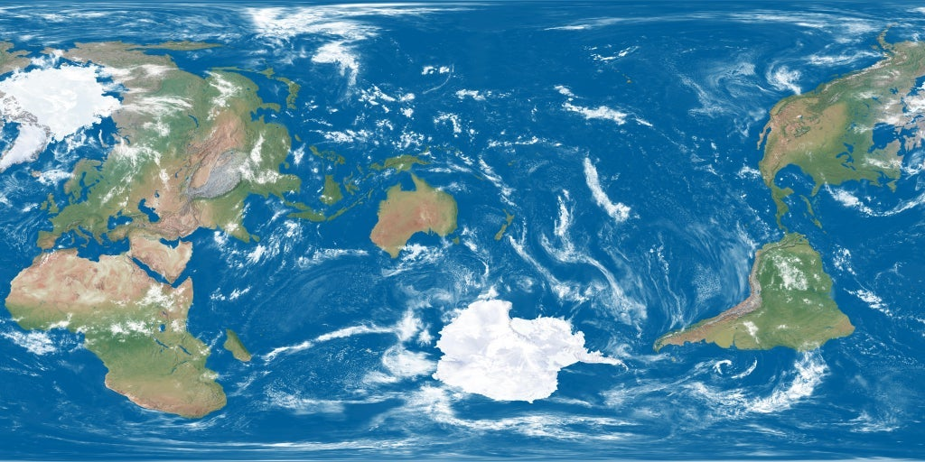
Projections.
Earth centred on NZ

Slide 45
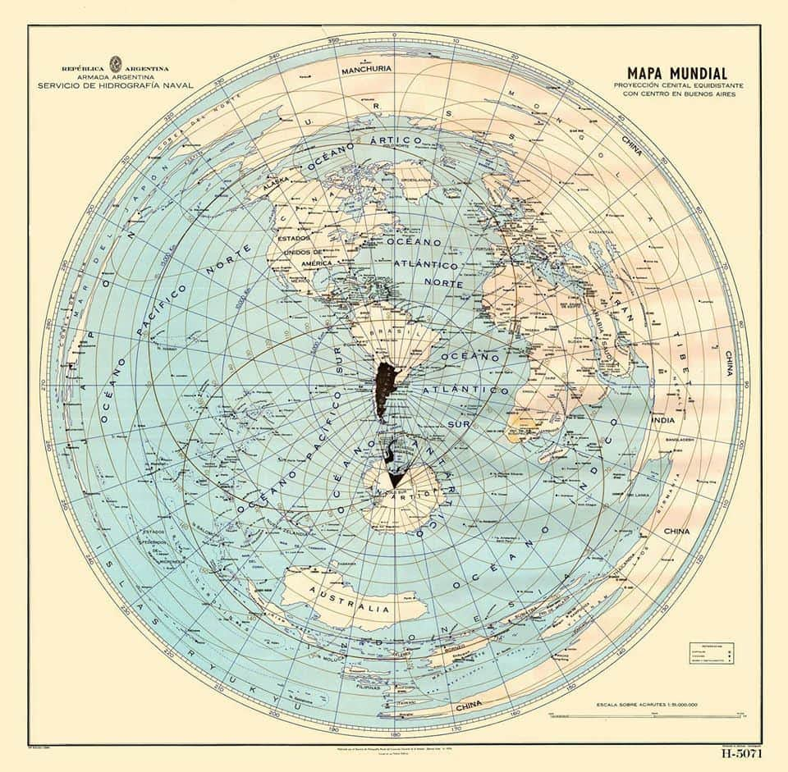
Projections.
World centred on Buenos Aires
Conclusions:
All projections distort
The larger the area, the greater the distortion at the edges in many projections.
Think about the analytical implications of your projection. How does it drive your story?

Slide 46
Data 1.
GeoJSON and TopoJSON. The data you need to draw your map
Based on the JSON format. {“key”: “value”} pairs
GeoJSON data in the form of arrays, [X, Y]. Sets of arrays can be used for:
Points
Lines
Polygons
TopoJSON data in the form of arcs. These are sequences of points.
Topo from topology, not from topography. [Not about mountains].
Arcs are only defined once, so storage much smaller.
Files more complicated, and not intuitive to read with human eye.
Not so good with user-collected points
Very good when regions line up next to one another, as in political/state maps.

Slide 47
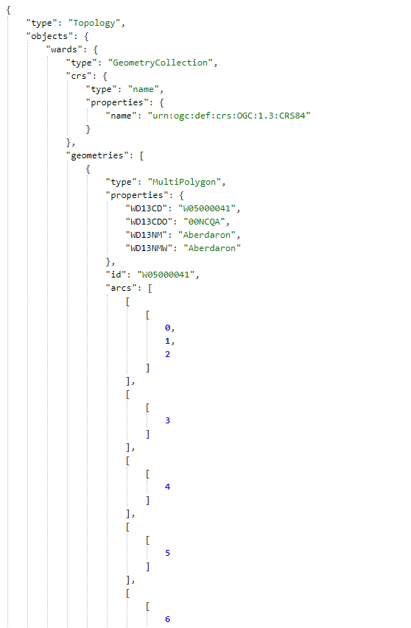
Base maps
Data sources
The base TopoJSON files are open source:
US-Atlas. https://github.com/topojson/us-atlas
UK files. https://martinjc.github.io/UK-GeoJSON/

Slide 48
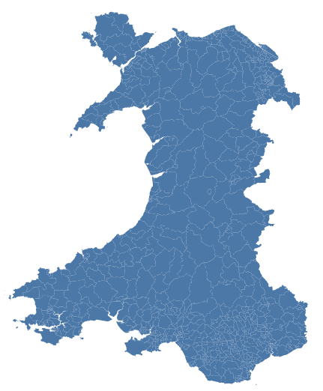
Base maps
First simple map
{
"$schema": "https://vega.github.io/schema/vega-lite/v5.json",
"data": {
"url": "https://raw.githubusercontent.com/RDeconomist/RDeconomist.github.io/main/charts/maps/geoWalWards.json",
"format": {"type": "topojson",
"feature": "wards"}},
"projection": {"type": "mercator"},
"mark": {"type": "geoshape"}
}

Slide 49
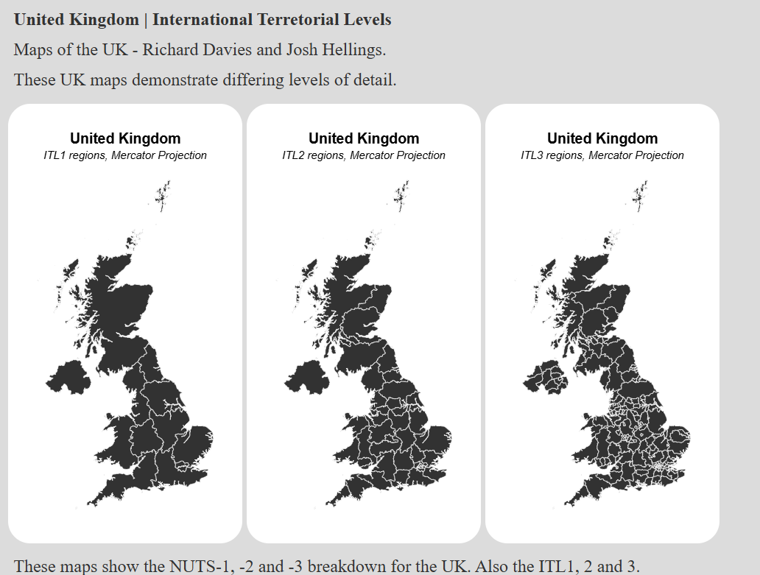
Regions
How local do you want to be?

Slide 50
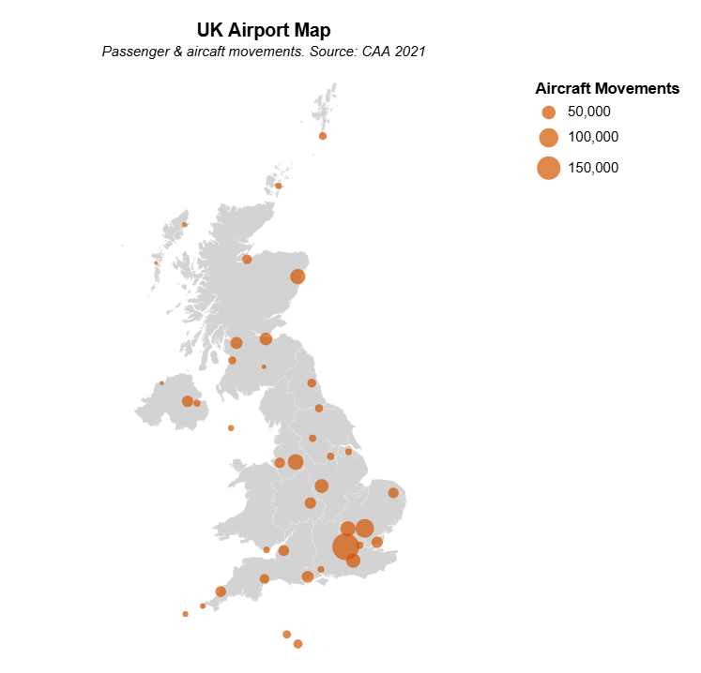
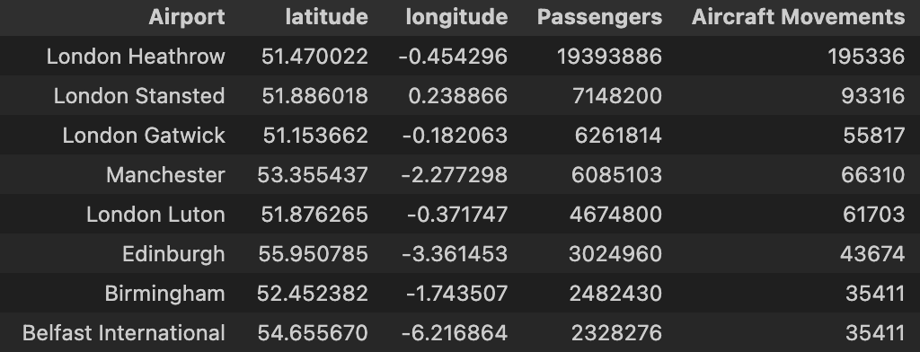
Maps + coordinates
Plotting specific points on a map
If our data is point rather than area based, we can just plot a points map.
Two data sources:
UK map (Geo or TopoJson)
CSV with data + coordinates

Slide 51
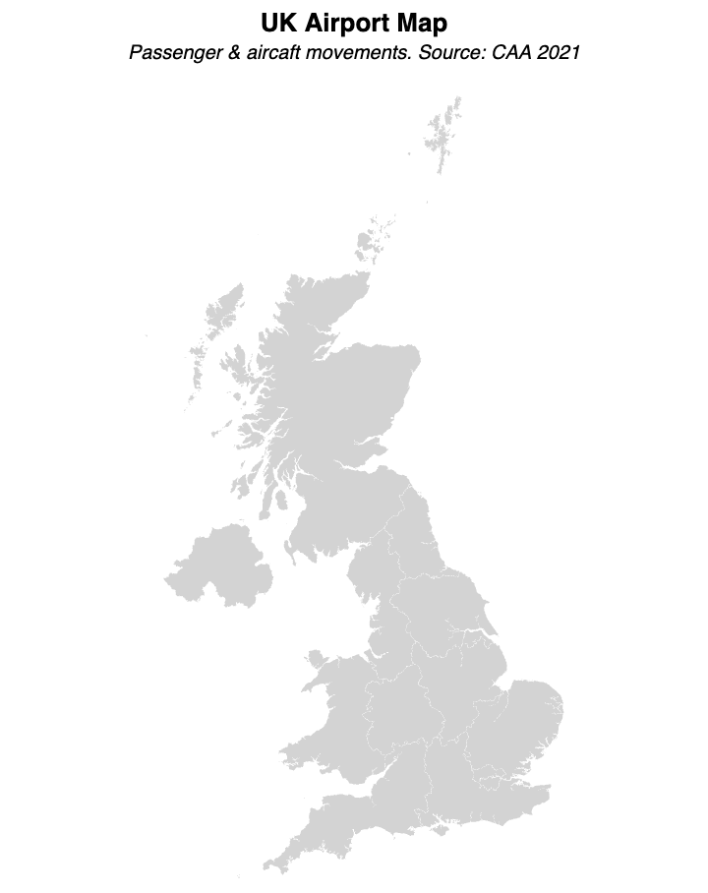
Maps + coordinates
Plotting specific points on a map
Our chart will have two layers:
“geoshape”: Base map outlining UK and regions
“points”: location of each observation
In our geoshape layer, we set our set our projection type. We don’t need any encodings to show the map.
{
"data": {"url": "ITL1_2021_20m.geojson", "format": {"property": "features"}}, "projection": {"type": "mercator"},
"mark": {
"type": "geoshape",
"fill": "lightgray",
"stroke": "white",
"strokeWidth":0.1
},
}

Slide 52
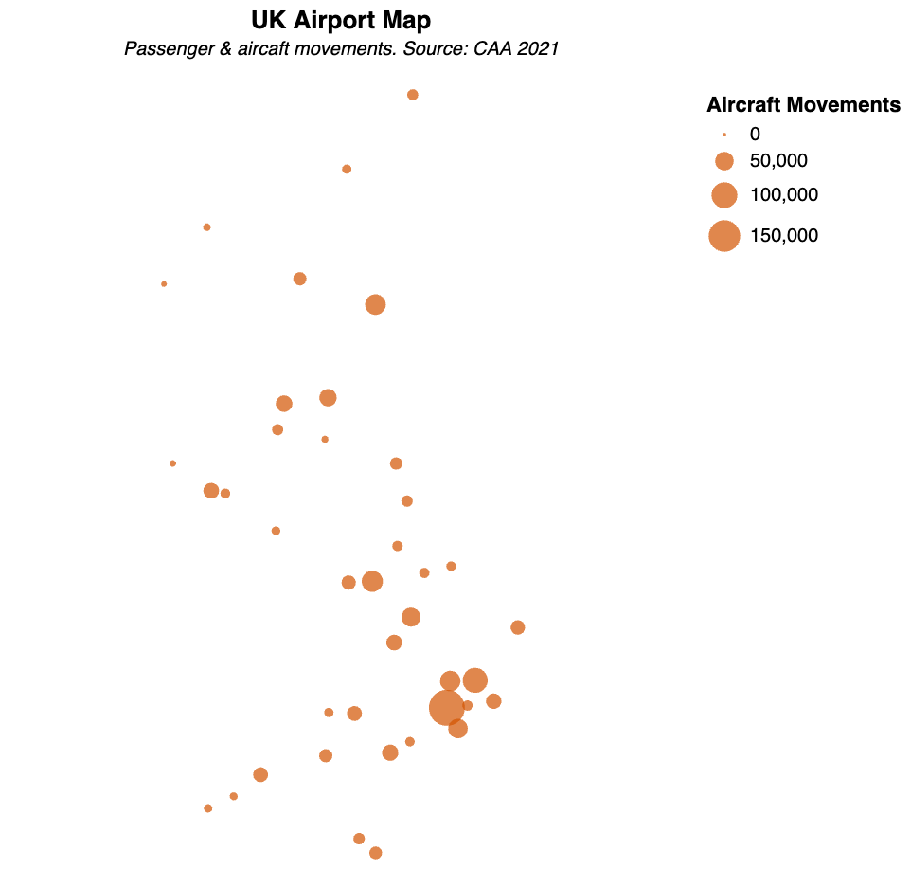
Maps + coordinates
Plotting specific points on a map
Our chart will have two layers:
“geoshape”: Base map outlining UK and regions
“points”: location of each observation
In our points layer, we encode our latitude and longitude to these visual channels.
{
"data": {"url": "UK_airports2.csv"},
"mark": {”type": "circle”},
"encoding": {
"longitude": {"field": "longitude", "type": "quantitative"},
"latitude": {"field": "latitude", "type": "quantitative"},
"size": {"field": "Aircraft Movements", "type": "quantitative"},
}
}

Slide 53
Maps + coordinates
Plotting specific points on a map
Using a layer, we combine the map and the points into a single chart.
"layer": [
{
MAP CHART
}
{
POINTS CHART
}
]

Slide 54






Maps + data
Making a choropleth
The base map
We form choropleth maps by linking numeric entries with geographic data.
Features:
Country | ISO3 | value
Afghanistan | AFG | 1665
Albania | ALB | 15709
Algeria | DZA | 4216
… | … | …
Yemen, Rep. | YEM | 594
Zambia | ZMB | 3555
Zimbabwe | ZWE | 2323
properties:{
‘ISO3’: ‘AFG’,
‘name’: ‘Afghanistan’
}
properties:{
‘ISO3’: ‘ALB’,
‘name’: ‘Albania’
}
properties:{
‘ISO3’: ‘DZA’,
‘name’: ‘Algeria’
}
properties:{
‘ISO3’: ‘YEM’,
‘name’: ‘Yemen’
}
properties:{
‘ISO3’: ‘ZMB’,
‘name’: ‘Zambia’
}
properties:{
‘ISO3’: ‘ZWE’,
‘name’: ‘Zimbabwe’
}
To do this, we use a common key to match the two datasets.

Slide 55
Maps + data
Making a choropleth
We form choropleth maps by linking numeric entries with geographic data.
In Vega-lite, we do this with a lookup transform:
"transform": [
{
"lookup": "properties.ISO3",
"from": {
"key": "ISO3",
"fields": ["country", "value"],
"data": {
"url": ”[…]/data.csv"
}
}
}
]
Country | ISO3 | value
Afghanistan | AFG | 1665
Albania | ALB | 15709
Algeria | DZA | 4216
… | … | …
Yemen, Rep. | YEM | 594
Zambia | ZMB | 3555
Zimbabwe | ZWE | 2323

Slide 56
Maps + data
Making a choropleth
We form choropleth maps by linking numeric entries with geographic data.
In Vega-lite, we do this with a lookup transform:
"transform": [
{
"lookup": "properties.ISO3",
"from": {
"key": "ISO3",
"fields": ["country", "value"],
"data": {
"url": ”[…]/data.csv"
}
}
}
]
Country | ISO3 | value
Afghanistan | AFG | 1665
Albania | ALB | 15709
Algeria | DZA | 4216
… | … | …
Yemen, Rep. | YEM | 594
Zambia | ZMB | 3555
Zimbabwe | ZWE | 2323

Slide 57

Maps + data
Making a choropleth
By matching every country, we create a choropleth:

Slide 58
Practical session. https://rapidcharts.io/maps

Slide 59
Break. Take a look at the maps on the rapidcharts site https://www.rdeconomist.github.io/maps Copy the following two files to your GitHub: File: github.com/jhellingsdata/RADataHub/blob/main/misc/Guinness_Map/UK_LADs.topojson Raw: github.com/jhellingsdata/RADataHub/raw/refs/heads/main/misc/Guinness_Map/UK_LADs.topojson File: github.com/jhellingsdata/RADataHub/blob/main/misc/Guinness_Map/pint_data.csv Raw: github.com/jhellingsdata/RADataHub/raw/refs/heads/main/misc/Guinness_Map/pint_data.csv

Slide 60
Break. Take a look at the maps on the rapidcharts site https://www.rdeconomist.github.io/maps Copy the following two files to your GitHub: File: https://github.com/RDeconomist/RDeconomist.github.io/blob/main/charts/maps/geoUSStates.json Raw: https://raw.githubusercontent.com/RDeconomist/RDeconomist.github.io/main/charts/maps/geoUSStates.json File: https://github.com/RDeconomist/RDeconomist.github.io/blob/main/charts/maps/dataUSstatesCrimeWide.csv Raw: https://raw.githubusercontent.com/RDeconomist/RDeconomist.github.io/main/charts/maps/dataUSstatesCrimeWide.csv

Slide 61

FM: Practical: Point example and Choropleth example

Slide 62


Slide 63



